Slide 1
A New Approach to Accelerate Skin Healing
Fluorescent Light Therapy
Acacia M. Roman,dvm
Technical services veterinarian
Vetoquinol usa
Notes:
Hello everyone. Thank you all for joining us today. The objective of this mini session is to briefly go over Fluorescent Light Therapy, A New Approach to Accelerate Skin Healing. This is an innovative, in clinic, tech driven approach to heal the skin once, if present, an underlying condition is identified and addressed.

Slide 2
Mode of Action Video
Notes:
In this video we will have the opportunity to understand the mode of action of fluorescent light energy and its role in accelerate the healing of the skin

Slide 3
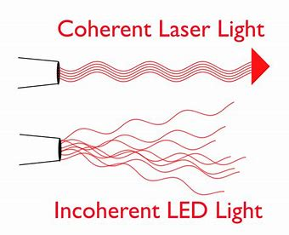
Introduction
Light Therapy
LASER Therapy (LLLT)
Monochromic
Tissue penetration is deep into the target areas
Great for addressing chronic pain or injuries
NEW Fluorescent Light Therapy (Phovia)
LED device + topical photoconverter gel (chromophore)
Targets all skin layers with polychromic light therapy
Great for addressing deep lesions
Notes:
Now that we have reviewed the mode of action of FLT, let us discuss the difference when compared to a traditional LASER. This type of light therapy is monochromatic (or one color), collimated, and coherent delivering a longer less energetic wavelength allowing for deeper tissue penetration. It is best incorporated when we want to target beyond the subcutaneous layer.
Many clinics are using therapy lasers to target muscle and tendon injuries and an excellent option for chronic conditions like osteoarthritis.
Next, we have LED light therapy. LED stands for Light emitting Diode. This is an extremely safe and non-invasive form of light therapy. It’s great for addressing the superficial skin layer. LED light therapy will produce a non-coherent beam of light therapy. The non-coherent light beam provides a wider tallow for less treatment time. LED light target superficial layers of the skin, controls bacteria colonization and reduces the inflammation.
Fluorescent light energy is generated when you utilize the LED device to illuminate a photoconverter gel which contains light absorbing molecules or chromophores. The blue light will be amplified by these chromophores and other colors will be generated (gel will act as a prism) transmitting that energy into deeper layers of the skin simultaneously. Fluorescence light therapy is a form of light therapy that uniquely harnesses the power of fluorescent light energy (FLE) to trigger natural living biological systems and stimulate the skin's own biological processes and repair mechanisms. FLE penetrates the damaged skin at varying depths and activates numerous repair mechanisms. It initiates biological responses in the lesion or wound, including the stimulation of mitochondria and the modulation of cellular signaling pathways.
Very simply put, the difference between the two is FLUORESCENCE

Slide 4
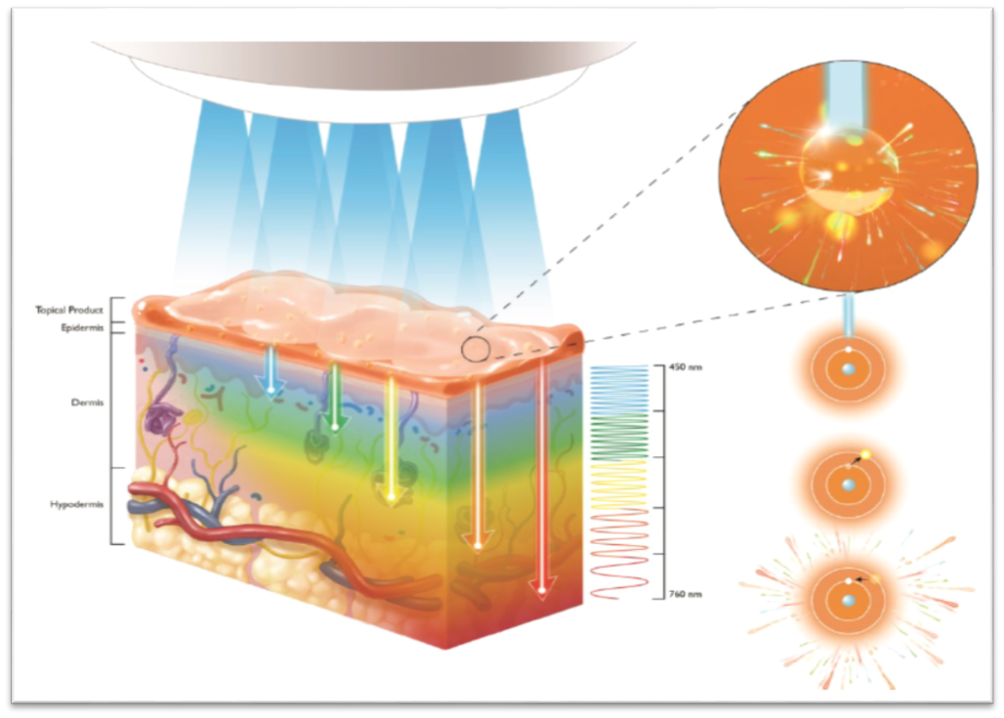
Introduction
Fluorescent light therapy
Fluorescent light therapy (FLT) utilizes fluorescence light energy (FLE)
FLE is generated by stimulating light-absorbing molecules (chromophores) within a topical gel
To produce FLE we apply a chromophore gel to the affected area of skin (lesion) and illuminate the gel with a multi-LED lamp. FLE provides a broad spectrum of wavelengths capable of penetrating skin at different depths simultaneously.
Notes:
FLE is generated by stimulating light-absorbing molecules (chromophores) within a topical photo-converter gel.
To produce FLE we apply a chromophore gel to the lesion on the skin, and illuminate this gel with a multi LED lamp. Upon exposure to the LED light, the chromophore gel acts as a photo converter and starts emitting fluorescent energy into the multiple layers of the skin. FLE provides a broad spectrum of wavelengths capable of penetrating skin at different depths simultaneously.

Slide 5
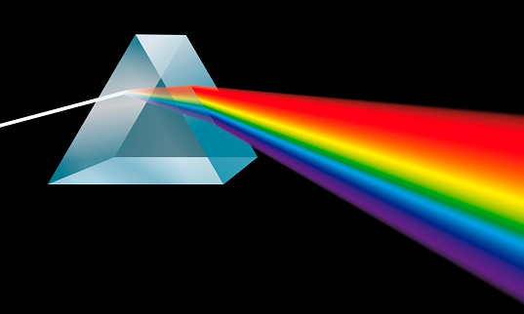
Introduction
Fluorescent light therapy
A chromophore is the part of a molecule responsible for its color.
The skin naturally contains a range of endogenous chromophores which have scattering and absorption coefficients.
The chromophore gel absorbs the incoming LED light and converts it into FLE
Allowing for a deeper penetration into the skin due to longer wavelengths of fluorescence
Notes:
A chromophore is the part of a molecule responsible for its color. Absorbs light at a specific frequency and so imparts color to a molecule. Use of a topical chromophore gel in conjunction with LED light, produces a longer FLE wavelength than LED light alone

Slide 6
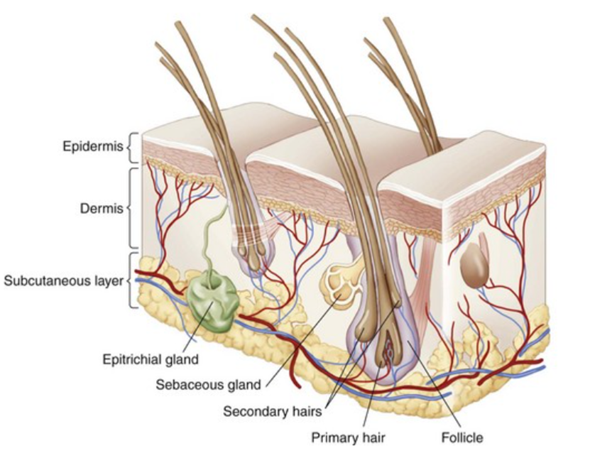
Mode of Action
Fluorescent light therapy
Blue Light – Targets superficial layers of the wound, controls bacteria colonization, and reduces the inflammation
Notes:
The way light energy interacts with the tissues will depend on the wavelength and the tissue constituents. We know that Blue Light – Targets superficial layers of the skin, lesion or wound, colonization of bacteria in the epidermis, and reduces the inflammation

Slide 7
Mode of Action
Fluorescent light therapy
Green Light – Deeply penetrates the skin and stimulates the fibroblasts and keratinocytes proliferation, stimulates angiogenesis, and reduces inflammation
Notes:
Green Light – will be acting beyond the epidermis targieting the basal layer and the upper dermis stimulating fibroblasts and keratinocyte proliferation, angiogenesis, and reducing inflammation
.

Slide 8
Mode of Action
Fluorescent light therapy
Yellow Light – Stimulation of the mitochondria, increases ATP production, stimulates fibroblasts activity, and blood circulation.
Notes:
Yellow wavelength targets deeper into the dermis and stimulates the mitochondria, increasing ATP production, stimulating fibroblasts activity which is collagen production, and increase blood circulation.
ATP – Facilitates a variety of cellular processes that are essential to life and healing.

Slide 9
Mode of Action
Fluorescent light therapy
Orange/Red Light – Induce the dissociation of nitric oxide (NO) from cytochrome C oxidase (CCO)and regulates collagen production
Notes:
The orange/red wavelength will be inducing the dissociation of nitric oxide from the cytochrome C oxidase which is the respiratory enzyme located in the mitochondria. We also see that the fibroblast activity will be regulated and that is the production of collagen
CCO is a respiratory enzyme located in the mitochondria,
Light therapy works directly on the mitochondria and increases ATP it also activates CCO.
This is a fancy way of saying that we are going to increase circulation and decrease inflammation.
We are also going to stimulate those fibroblast to produce collagen

Slide 10
Summary
Fluorescent light therapy
Healing with the Speed of Light
Fluorescent light therapy stimulates cell regeneration, reduces inflammation, and relieves pain by targeting deeper skin layers for more complete healing. FLE is clinically proven to accelerate healing for most skin lesions and may reduce recovery time by 50%.
More wavelengths = Deeper repair
Notes:
Reduce treatment time on damaged skin
Reduce the need for systemic antibiotics
And this can be preformed by anyone in the clinic

Slide 11
The Phovia System
Notes:
Phovia is considered a system because it is composed of→

Slide 12
Product Details
The phovia system
Notes:
Two parts: a light emitting lamp and a photoconverter gel. The Phovia lamp has a specific wavelength, 440-460 nm and intensity designed to optimize both the activation of chromophores for production of pulsing FLE (520-630 nm) and provide the known beneficial effects. Again, the photoconverter gel with the chromophores will act as a prism amplifying the blue LED light into the other wavelengths allowing the energy to penetrate all layers of the skin simultaneously.

Slide 13
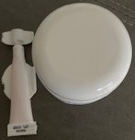
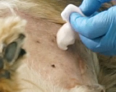
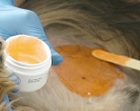
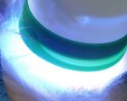
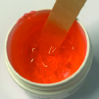
How to Apply
The phovia system
Step 1 Step 2 Step 3 Step 4 Step 5
Prepare the Pet
Remove any dressings,
clip and clean the skin
using sterile saline
Apply the Gel
Apply 2 mm of gel
across the area
Illuminate Gel
PUT YOUR ORANGE GLASSES ON
During the 2-minute application, light absorbing molecules are activated by blue light generating Fluorescent Light Energy (FLE)
Clean Gel
Once cleaned repeat step 3, 4, and 5 for a back-to-back protocol
Prepare the Gel
Wearing gloves
mix the 2 gels
See Phovia Instructions for Use for full application instructions
Notes:
How do we apply Phovia
The first step is to prepare the patient to receive the Phovia applications. It is highly recommended to clip or shortened the hair if covering all or part of the lesion to bee illuminated to allow the gel to come in contact with the skin. May need to clean the lesion with chlorhexidine or saline to remove present debris, scab, or exudate. Refrain from using iodine base antiseptics as these have chromophores and we do not know what type of interaction may occur with the photoconverter gel.
Apply a 2mm layer of gel to the affected area. This is about the height of a quarter. You can apply directly to open lesions and be sure to incorporate healthy tissue edges.
Keep the lamp as close to the patient as possible (no more than 5 cm away) without touching for the duration of the treatment. The lamp will AUTOMATICALLY shut off after 2 minutes. The outer rubber bank is both removable and washable. As recommended by the manufacturer, can be wiped with water and disinfected with ethyl alcohol or chlorhexidine.
Do not move the lamp during treatment.
In between applications, carefully and gently wipe area clean with saline. Pat dry. A wet surface may cause the gel to foam slightly.

Slide 14
How to Use
Notes:
In this video we can review all the steps to be followed before, during, and after the Phovia applications

Slide 15
Applications
The phovia system
Deep Bacterial Pyoderma
Superficial Pyoderma
Traumatic wounds
Burns
De-gloving Injuries
Road Rash
Bites
Cuts
Pyotraumatic Dermatitis
Second Intention Healing
Perianal Fistulas
Lick Granulomas
Hotspots
Abscesses
Interdigital furunculosis
Complicated/Uncomplicated Surgical Wounds
Notes:
The Phovia System can be used anytime we want skin healing…here are some examples where we can consider Phovia. What do you think? Everyday? Yes, we see at least one of these cases every single day in general practice.

Slide 16
Disclaimer
Phovia
Phovia has only been studied in dogs and cats at this point.
There is no data with using Phovia in horses yet. Studies are ongoing.
Use caution/avoid on areas where suspicion of malignancy exists.
In many cases, not treating the underlying cause of skin disease may result in re-occurrence.
Notes:
Phovia is recommended to be used in dogs and cats at this time. Please consult with one of our Technical Services Veterinarians if wanting to explore its use in other species. Waiting for some results in controlled equine cases. In case of malignancies, please refrain from using Phovia until confirmed clean edges after surgical mass excision. No data at this point to safely make a recommendation since data is conflicting.

Slide 17
PHOVIA IN ACTION
Notes:
I want to share some field cases of what we can achieve with Phovia

Slide 18
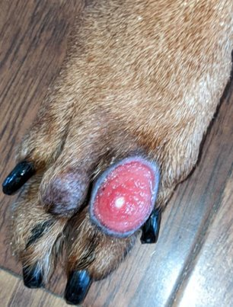
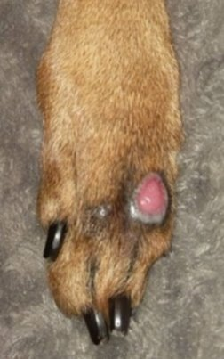
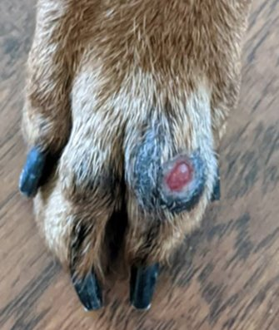
Luca: 8-year-old Doberman with acral lick granuloma due to stressful move. Patient was on oral steroids with no positive effect, E-collar prior to Phovia Application
PHOVIA #1 8 days post PHOVIA #3 2 Weeks Post Phovia #3
JANUARY 16, 2022
FEBRUARY 10, 2022
FEBRUARY 16, 2022
Notes:
The Phovia System can be used anytime we want skin healing. This is Luca, a stressed 8-year-old Doberman Pinscher. Pet parents were moving, and Luca started licking. Oral steroids and E-collar were prescribed with no improvement. The first Phovia application (2-2 min applications) were delivered on January 16 of 2022. Applications continued in the same manner (back-to-back) weekly and the middle picture shows the improvement 8 days after the third and last Phovia application. February 16, 2022 we see that the progressive healing of the lick lesion. Luca is on fluoxetine now to address the underlying condition.

Slide 19
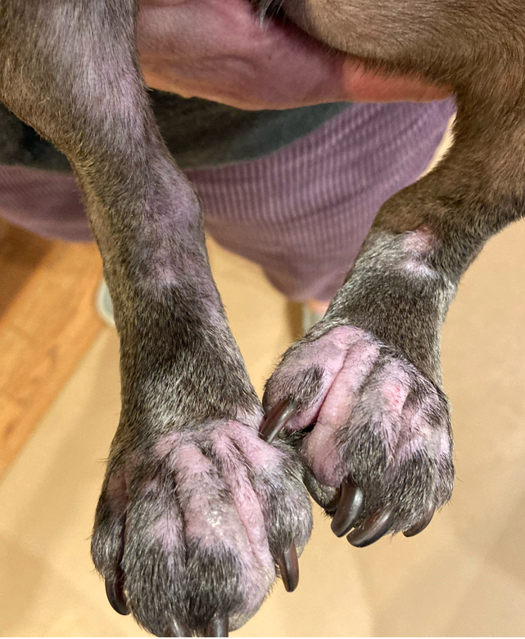
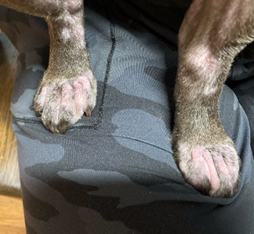
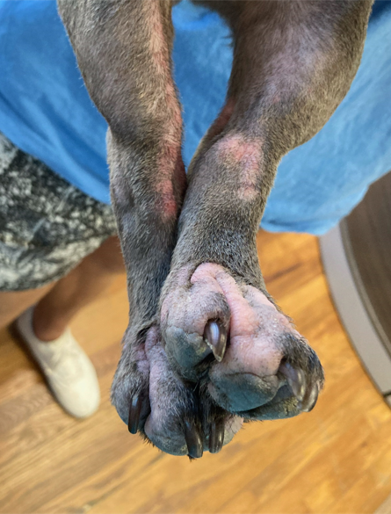
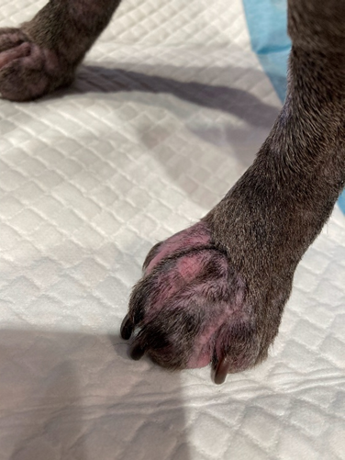
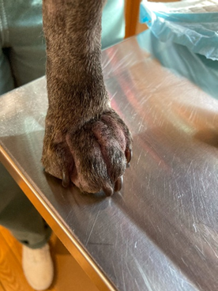
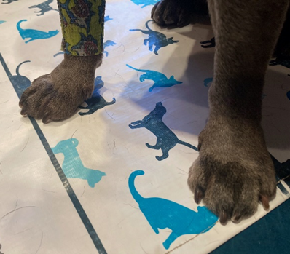
Billie Shannon - 5 Weeks of Phovia Treatment
DECEMBER 27, 2021
DECEMBER 30, 2021
DECEMBER 15, 2021
JANUARY 16, 2022
JANUARY 4, 2022
JANUARY 12, 2022
MAY 17, 2022
Notes:
Billie Shannon, 3.5-year-old French Bulldog. She was surrendered by previous owner due to chronic skin condition sparing euthanasia. Was adopted Mid-May 2021 by a current client of Dr. Shower and brought into clinic in September 2021for generalized skin lesions. Not on any HW/Flea/Tick prevention at that time. Previous diagnostic and treatment history was unknown.
Dr. Shower performed a full derm workup that included skin scrape which was negative and skin cytology confirmed diagnosing the presence of cocci and yeast. Owner did not want to use oral antifungals. Started Billie on Apoquel, Bravecto, Duoxo Shampoo, wipes and Calm Mousse (bathing weekly for a month then every other week for a month, now down to spot treatments only and bathing every other month to maintain).
In December 2021 Billie’s condition had worsened and Dr Shower decided to start Phovia applications and Billie tolerated it extremely well, even on the face. A hydrolyzed diet was included in the protocol on December 30. Did roughly 6-7 treatments and then owner stopped coming in for treatments because Billie’s skin condition had improved, and no flares were evident.
In May of 2022, Billie came in for her annual exam and Dr. Shower and staff were floored by Billie’s appearance and healed skin. She was slightly pruritic, so even though she is still on Apoquel and hydrolyzed diet, they added Cytopoint to the treatment plan.

Slide 20
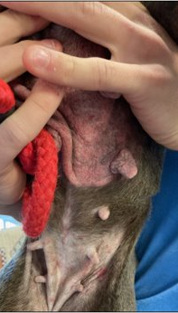
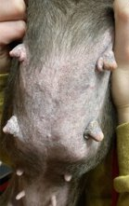
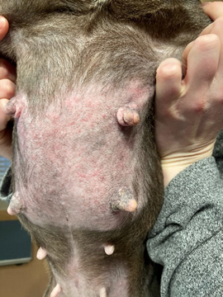
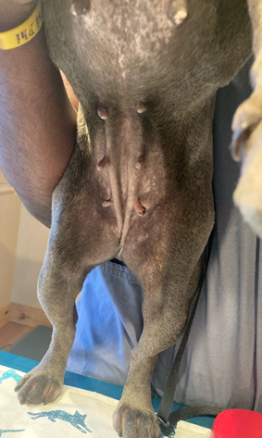
Ventral Pyoderma – Billie
PHOVIA #1 PHOVIA #2 PHOVIA #3 PHOVIA #4 5 MONTHS
DECEMBER 15, 2021
DECEMBER 30, 2021
JANUARY 4, 2022
JANUARY 12, 2022
MAY 17, 2022
Notes:
Just follow the timeline and appreciate how incorporating Phovia in this allergic dog will reduce the flaring events caused by secondary infections that occur frequently

Slide 21
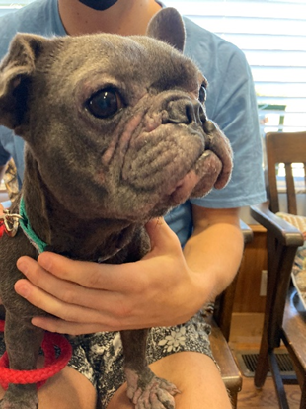
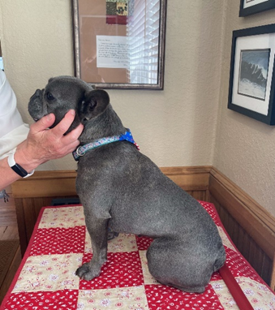
Facial Pyoderma – Billie
PHOVIA started 5 Months since phovia started(4 weeks of treatments)
May 17, 2022
May 17, 2022
December 15, 2021
Notes:
More before and after pictures of Billie’s face

Slide 22
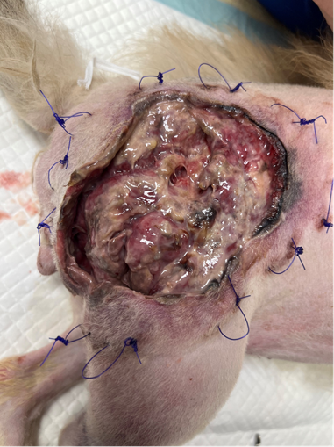
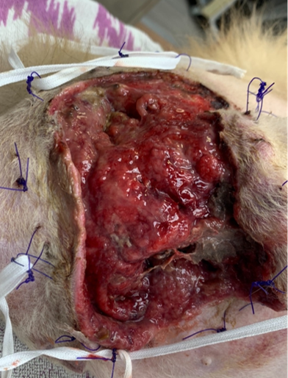
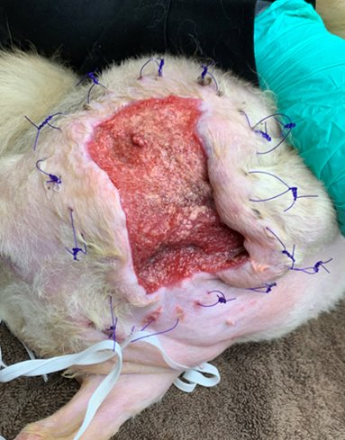
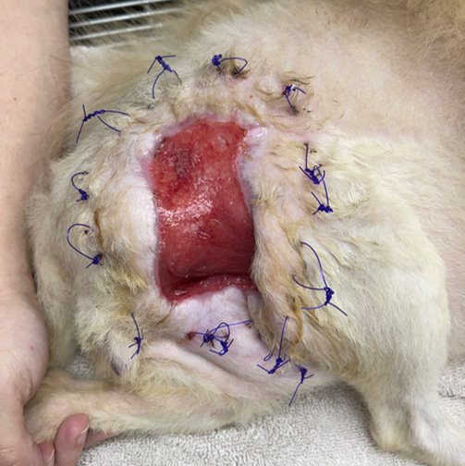
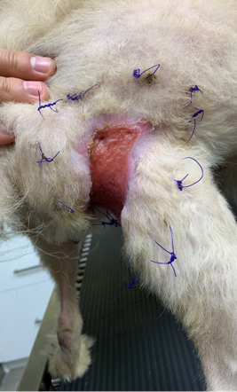
Lulu: 9-year-old Pomeranian presented with necrotic hip post-dog attack bite wound. First 9-days treated as open wound. C/S performed. Started IV antibiotics and injectable Nsaids. Manuka honey and tie-over bandage changes. Several debriding sessions needed before introduction of Phovia
Enter er start phovia #1 phovia #2 phovia #3 phovia #4
Patient set to go home in 2 days. No more antibiotics or bandage changes
april 18, 2022 april 27, 2022 may 4, 2022 may 11, 2022 may 18, 2022
Notes:
This is Lulu. She is a 9-year old Pomeranian that was attack by another dog. Initially presented with bite wounds (date unknown) and then came back in on April 18th,2022 with it looking like this (first picture)……the technicians said the odor filled the whole room.
The necrotic tissue was debrided and an initial culture was sent out. The culture came back sensitive to enrofloxacin (Baytril). They had started her on injectable Rimadyl, Baytril SID and Ampicillin TID. After 1st week she was transferred to oral medications. Continued immediately treating with open wound management. Manuka Honey BID to start with and a tie over bandage, cleaning with Chlorhexidine and debriding necrotic tissue. Continued with 24-hour bandage changes and Baytril for 4 weeks. Started Phovia on April 27th and continued weekly for a total of 3 treatments with the photos below. Last Phovia application was on May 18
According to the technicians, Lulu was licking the belly band and running around outside and all over the house. When she came back in for her bandage change, she was given an e-collar and asked to have her wear it. Owner came in the next day and the e-collar was not being utilized. They decided to continue her treatment as medical boarding.
FYI – 4 weeks of Phovia total but we do not have pictures after the last Phovia application

Slide 23
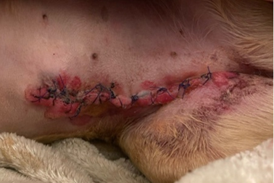
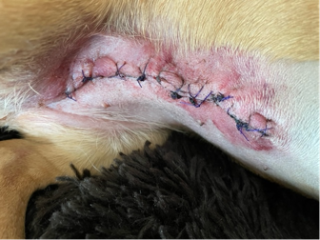
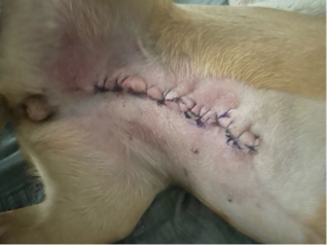
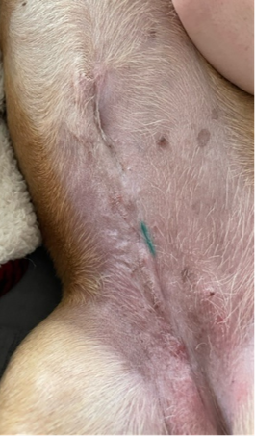
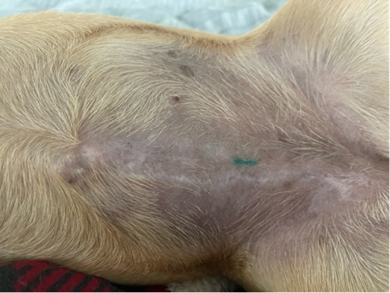
Cami: 8-year-old Mixed Jack Russell/Dachshund with a mammary mass (lipoma-post pathology report). DVM decided to remove the full mammary chain since this is a rescue and there was no prior documented history
January 7, 2022 January 8, 2022 January 11, 2022
January 30, 2022 march 17, 2022
Notes:
This is Cami, an 8y/o Jack Russell/Dachshund presented with a mammary mass. After surgical resection of the mass pathology results came back as a lipoma. The first picture is from the day of the surgery. The area is inflamed and Phovia applications were started immediately and continued once a week for a total of 3 Phovia applications. The scar is hardly noticeable as you can see in the last picture,

Slide 24
Comparison
The phovia system
Phovia System
No need to determine dose
Preset energy output and
2-minute timer with AUTO shut-off
Multiple wavelengths = Multiple Skin Layers
ONCE a week applications
Treatment time 4 Minutes
Gel On, Lamp On, Wipe Off
SKIN, SKIN, SKIN
LED Light
Traditional Laser
Laser is one wavelength = ONE Depth
Complicated setup for energy output needed depending on the target tissue(s)
Great for Deep Areas
Bladder
Otitis Externa
Joint
Muscle
Recommended 2-3 Times a Week
Must keep moving during treatment....no risk of burn
Laser can damage retinas
Notes:
Just making sure that we establish the difference between Phovia and your traditional LASER. Never forget that the major difference is fluorescence and Phovia does not emit UV light. I have a basic list of other differences to keep in mind…

Slide 25
Studies
Notes:
Let’s now briefly discuss a couple of published studies

Slide 26
Fluorescent light therapy studies
Objective
1. To evaluate the effect of FLE in managing deep pyoderma.
2.To evaluate and compare the effect of Fluorescent Light Energy associated with systemic antibiotics in comparison to only systemic antibiotics on clinical manifestations of deep pyoderma.
Materials and Methods
A total of 27 dogs with deep pyoderma lesions were randomly assigned to four groups:
• Group A: systemic antibiotic bid alone*
• Group B: FLE twice a week + systemic antibiotic bid*
• Group C: FLE once a week + systemic antibiotic*
• Group D: FLE twice a week
* All dogs underwent culture and sensitivity swab sampling at the time
at enrollment
Results
Summary: FLE adjunctive to systemic antibiotics was able to accelerate the clinical resolution and to reduce
the duration of exposure to systemic antibiotics compared to dogs treated with only antibiotics.
Notes:
This is the deep pyoderma study. The Objectives were to:
1. To evaluate the effect of FLE in managing deep pyoderma.
2. To evaluate and compare the effect of Fluorescent Light Energy associated with systemic antibiotics in comparison to only systemic antibiotics on clinical manifestations of deep pyoderma.
A total of 27 dogs with deep pyoderma lesions were randomly assigned to four groups after they underwent culture and susceptibility to R/O a resistant bacterial skin infection:
• Group A: systemic antibiotic bid alone*
• Group B: FLE twice a week + systemic antibiotic bid*
• Group C: FLE once a week + systemic antibiotic*
• Group D: FLE twice a week
The Response to therapy was assessed by reduction in lesion scores and improvement in lesion site cytological findings.
Skin biopsies for biomolecular analysis were obtained at baseline and after clinical resolution.
Results
Time to clinical resolution showed that group B showed marked improvement compared to group A
• Group A: Dogs treated with only systemic antibiotic achieved clinical resolution in 15.5 ± 3.5 weeks.
• Group B: Dogs treated with combination of systemic antibiotic + FLE twice a week achieved clinical resolution in 4.3 ± 1.3 weeks
Group C: Dogs treated with combination of systemic antibiotic + FLE once a week achieved clinical resolution in 5.4 ± 1.7 weeks.
Group D: Dogs treated twice a week with FLE
Biomolecular analysis
• At clinical resolution, skin biopsies from dogs
treated with FLE revealed up-regulation
of mRNA of different factors among which: EGF, NGF,
PDGF and MMP 9 (p≤0.01) compared to the expression
in dogs treated solely with antibiotic.

Slide 27
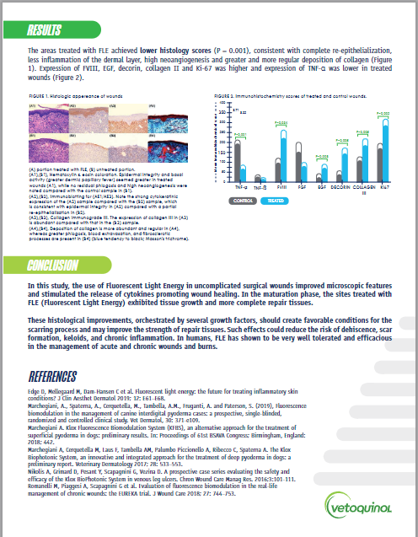
Fluorescent light therapy studies
Notes:
Now I will summarize the results of a study aimed to evaluate the effect of FLE on the healing of cutaneous incisional or surgical wounds.
It included 10 client owned dogs undergoing a TPLO. In these dogs, half of the length of each surgical wound was treated with FLE, and the remaining 50% was treated with saline solution on the first day after surgery and every 3 days until day 13. The areas that received FLE, achieved lower histological scores which are consistent with complete re-epithelization, less inflammation of the dermis, higher angiogenesis and a greater and more regular collagen deposition. Wound healing factors’ expression were higher in the FLE applied side of the incision and lower expression of the inflammatory cytokines compared to the non FLE half of the incisions. These should create favorable conditions for the scarring process and may improve the strength of repair tissue. Such effects could reduce the risk of dehiscence, scar formation, keloids, and chronic inflammation. FLE may be beneficial to manage incisional wounds, especially those at risk of delayed healing; for example those under tension, close to areas subject to movement, tension or traction.

Slide 28
BENEFITS FOR CLIENT
Phovia summary
ONCE A WEEK APPLICATIONS
NON-INVASIVE
COST EFFECTIVE
Up to 50% FASTER HEALING TIMES
LESS NEED FOR Rx MEDS/AT HOME TREATMENT
Notes:
What client benefits can we offer:
Phovia is a noninvasive, non thermal, innovative, that will improve the QoL not only of the patient but the pet parent as well in less time.
It is a once a week in clinic application that will increase compliance, improve outcome. Let us not forget that the incorporation of Phovia will help us continue to practice the responsible use of antibiotics.

Slide 29
BENEFITS FOR THE CLINIC
Phovia summary
QUICK IN-CLINIC APPLICATIONS
TECH APPOINTMENTS
100% GUARANTEED
2-YEAR SHELF LIFE ON GEL WHEN UNMIXED
2-YEAR FULL REPLACEMENT WARRANTY ON LAMP
Notes:
Phovia applications are tech driven appointments. This is a service that our clients can not purchase online, empowers your staff and we can still keep a close follow up with the patient. It is 100% guaranteed, like all Vetoquinol products. The unmixed gel has a 2-year shelf life, and the lamp has a full 2-year warranty.

Slide 30
Pricing
Notes:
You might be thinking, if I bring Phovia in, how should we charge?

Slide 31
Workflow
Fluorescent light therapy
Explain to client what you are recommending and provide the brochure and QR code for them to understand
Enter Phovia charges into computer system as a service (i.e., $60 single application area)
Have technician deliver the Phovia application to the patient
Schedule recheck exam for 1 week to assess condition
At recheck exam, perform next Phovia application if warranted
Continue this cycle until you are comfortable with the clinical resolution
At any point you may add in adjunctive therapies to your protocol as you see fit
Phovia can be added as an adjunctive therapy to your protocol to accelerate skin healing
Notes:
First, we suggest to establish a workflow. I understand that changing protocols can be challenging. The client needs to understand why you are recommending these applications and we have resources to help you educate them. Everyone in the practice needs to understand how Phovia will help the patient and start the conversation with the pet parent.
How to charge it? We recommend you consider how much your gel cost is, the time to prepare the lesion or lesions as well as the technician’s time. Also consider the patient, the number, size, and depth of the lesions.
Empower your staff to deliver the applications.
Schedule the follow up application and evaluations up front to create that client expectation.
Phovia applications will continue until clinical resolution of the lesion(s). Phovia is in most cases incorporated as an adjunct to your skin protocol.

Slide 32
Pricing Options (Suggestions Only)
Fluorescent light therapy
Post-Op Application (one time only) $10-$15 Add into the cost of surgery
Single Site Application $45-$60 per application – repeat weekly
Each Additional Site Application $20-$30 each
5 Week Application Package (1 site) $150-$250 Get 1 application FREE or 20% discount paying in advance.
All prices include a single back-to-back application consisting of total lamp time of 4 minutes (at 2-minute intervals each).
Notes:
These are some price suggestions
If you are using Phovia in your surgical incisions, you can build the price to the overall surgery price
If the patient has one lesion, this is the recommended price taking into account the price of the one gel pod and prep/tech time.
You can also have different Phovia packages to help guide pricing.
As you can see all of this suggested prices are for two two minute applications per lesion which is also refer to as the back-to back Phovia applications once a week per lesion.

Slide 33
What is my ROI?
Fluorescent light therapy
Profitability:
Initial Unit Cost: $0
Initial Gel Cost/Investment: $774
Containers of Gel: 25
Life of lamp = 10,000 treatments (4-min)
One jar per patient charging $60 per treatment
10,000 treatments x $60 each = $600,000 revenue
10,000 x $31 vet cost per jar of gel = $310,000
$600,000 - $310,000 = GROSS PROFIT TO CLINIC = $290,000 (over life of lamp)
Notes:
Remember that the initial investment will differ based on how they received their lamp (tiered promo, pay outright or 5 gel deal). With the 5 gel deal, they will have made back their initial cost after 13 treatments and the next 11 patients is pure profit.

Slide 34
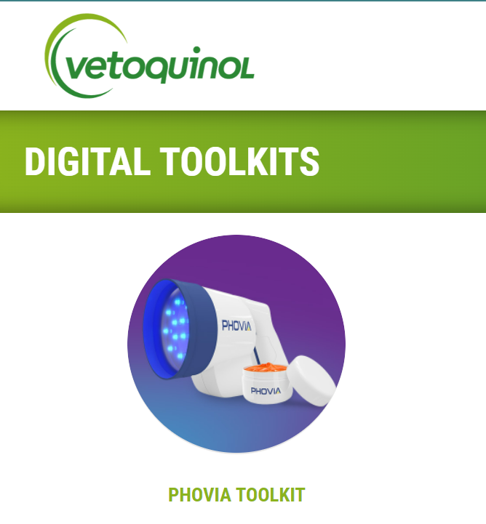
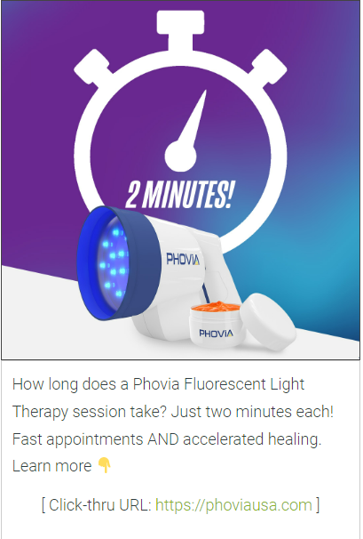
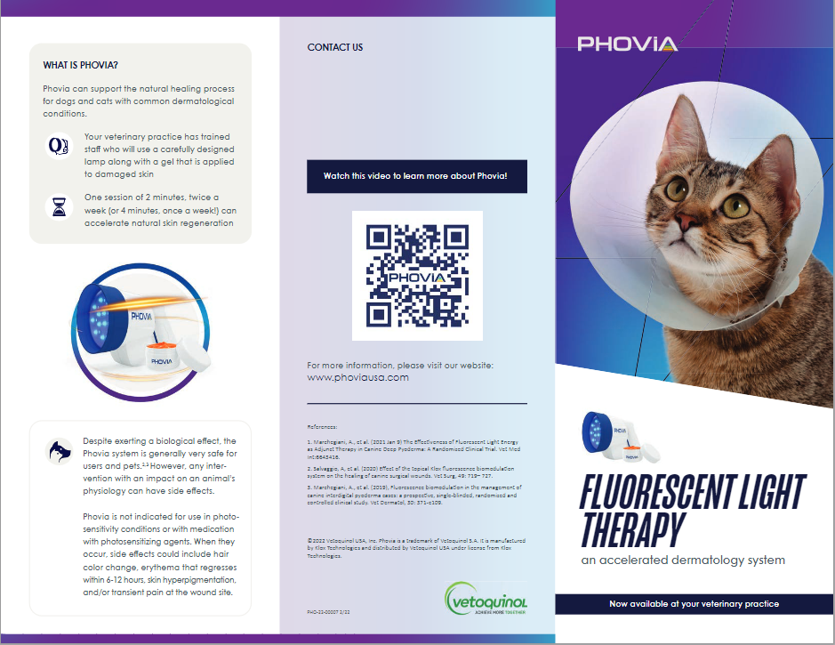
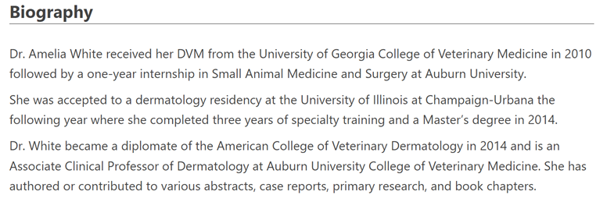
How to promote Phovia in your clinic?
Fluorescent light therapy
Amelia G. White, DVM, MS, DACVD
Notes:
These are resources that we are providing to help you consider Phovia every day in practice. Toolkits to help you promote it among your clients and region, and last but not least client brochures with QR code access to videos on mode of action and advantages of Phovia

Slide 35
Fluorescent light therapy
#lightitupwithphovia
Notes:
Follow us at hashtag light it up with phovia and upload before and after pictures of your successes!

Slide 36
References
Fluorescent light therapy
Marchegiani, A., Spaterna, A., Cerquetella, M., Tambella, A.M., Fruganti, A. and Paterson, S. (2019), Fluorescence biomodulation in the management of canine interdigital pyoderma cases: a prospective, single‐blinded, randomized and controlled clinical study. Vet Dermatol, 30: 371-e109.
Noli C. Staphylococcal pyoderma. In: Foster A, Foil C, eds. BSAVA Manual of Small Animal Dermatology. Gloucester: BSAVA Publications, 2003: 159–168.
Romanelli M, Piaggesi A, Scapagnini G et al. Evaluation of fluorescence biomodulation in the real-life management of chronic wounds: the EUREKA trial. J Wound Care 2018; 27: 744–753.
Marchegiani A. Klox Fluorescence Biomodulation System (KFBS), an alternative approach for the treatment of superficial pyoderma in dogs: preliminary results. In: Proceedings of 61st BSAVA Congress; Birmingham, England: 2018; 442.
Edge D, Mellegaard M, Dam-Hansen C et al. Fluorescent light energy: the future for treating inflammatory skin conditions? J Clin Aesthet Dermatol 2019; 12: E61–E68.
acacia.roman@vetoquinol.com
Notes:
Thank you all for your attention. Please feel free to ask questions on the chat or email them to

